Slide 1

Khulna University of Engineering & Technology (KUET)
Presentation prepared by
Rishadul Bayesh
1807086
Department of Computer Science and Engineering
10/5/2023
1

Slide 2

Outline
Introduction
The Past
Academics
Facilities
Clubs
Beauties of KUET
Achievement
Conclusion
10/5/2023
2

Slide 3

INTRODUCTION
One of the leading public engineering universities of Bangladesh.
Located at North-West corner of Khulna.
Recognized for its outstanding academic programs and research activites.
10/5/2023
3

Slide 4

The past
Started its’ journey as Khulna Engineering College in 1967.
In 1986, it changed its’ name into Bangladesh Institute of Technology (BIT).
Again renamed , its’ name into Khulna University of Engineering & Technology, Khulna in 2003.
10/5/2023
4

Slide 5
Academics
Offers under graduate and post graduate programs
3 Faculties
20 Departments
16 Departments offer undergraduate courses
1065 intake every academic year for BSc Engineering, B.URP and B.Arch.
10/5/2023
05

Slide 6
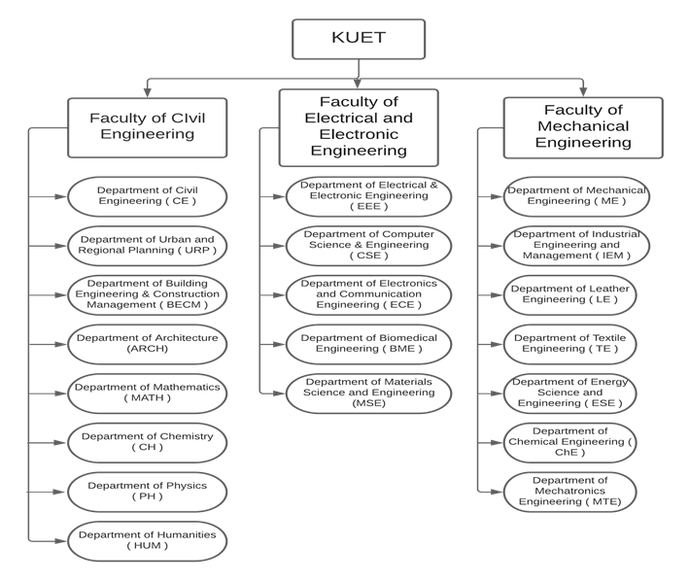
Flowchat of the Departments within faculties
10/5/2023
06

Slide 7
facilites
7 halls (6 for male and 1 for female students).
Dormitory for teachers and officers
Central Library
Medical Center
CCC (Central Computer Center)
Transportation
Water treatment plan
Residence for Staffs.
10/5/2023
07

Slide 8
Clubs of kuet
Overview
10/5/2023
08

Slide 9






01
02
04
03
05
06
Oks
( organization of kuet sports )
SGIPC
(Special Group of interest in programing contest)
KDS
(kuet debeting club)
KUET RADIO
dhrupodi
KBEC
(kuet business and enterpreneurship club)
10/5/2023
09

Slide 10
Beauties of kuet
Overview
10/5/2023
10

Slide 11
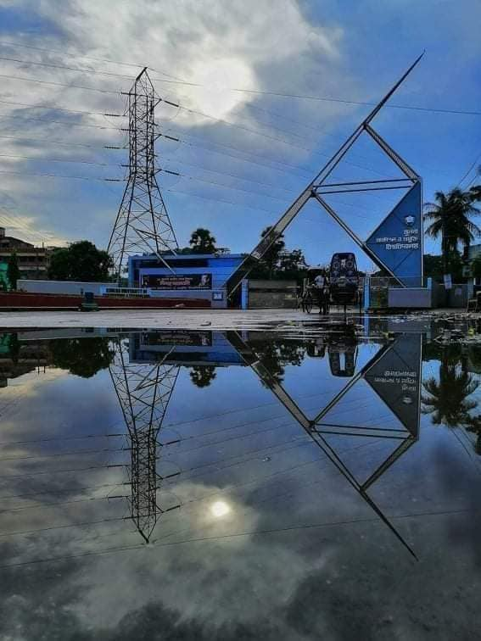
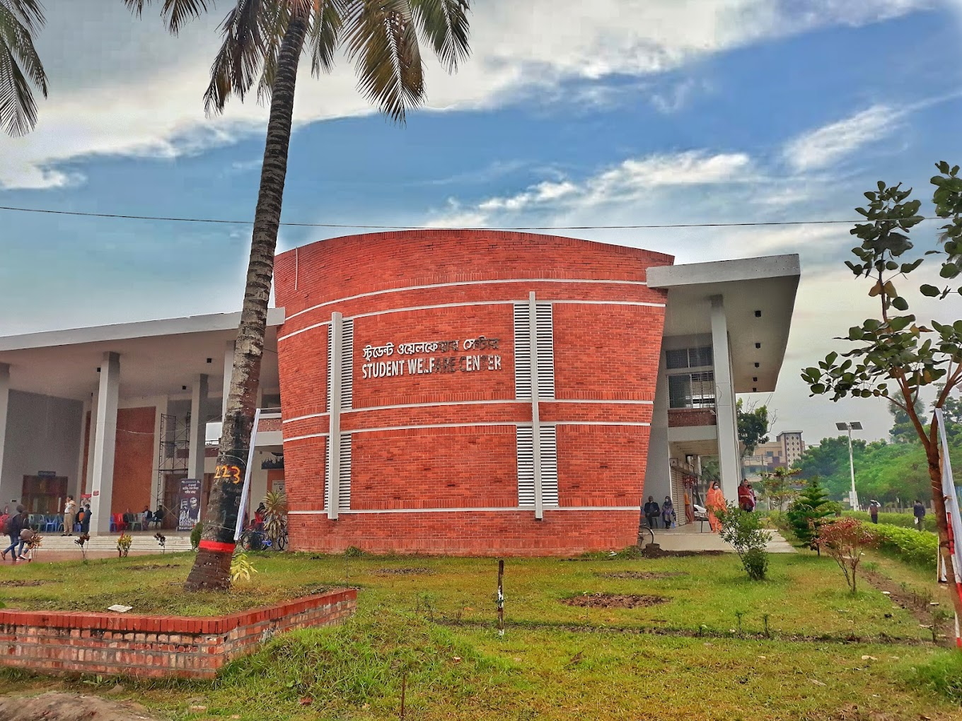
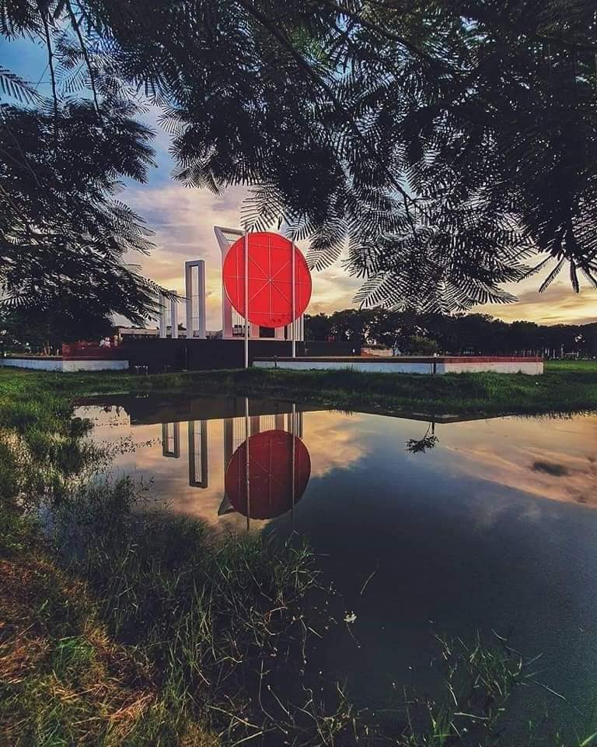
Beauties of kuet
Main Gate
Student Welfare Center
Shaheed Minar
10/5/2023
11

Slide 12
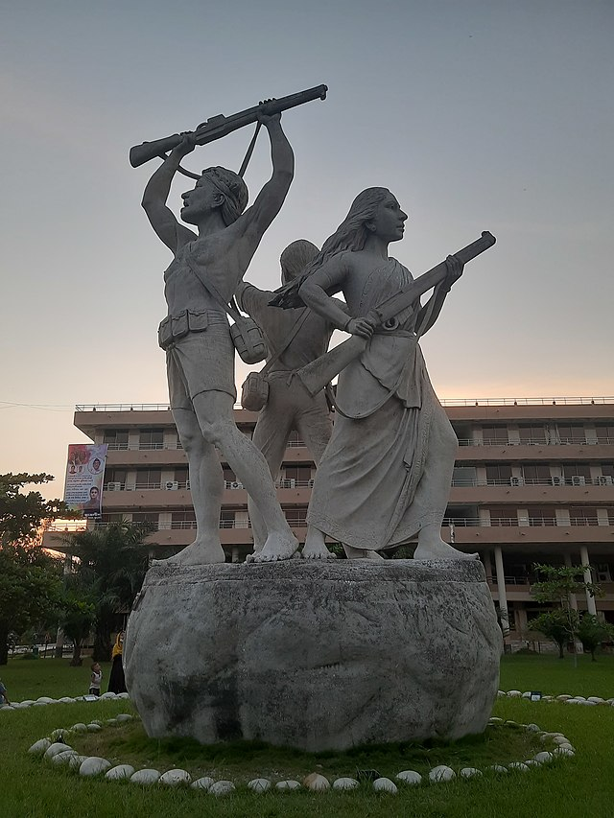
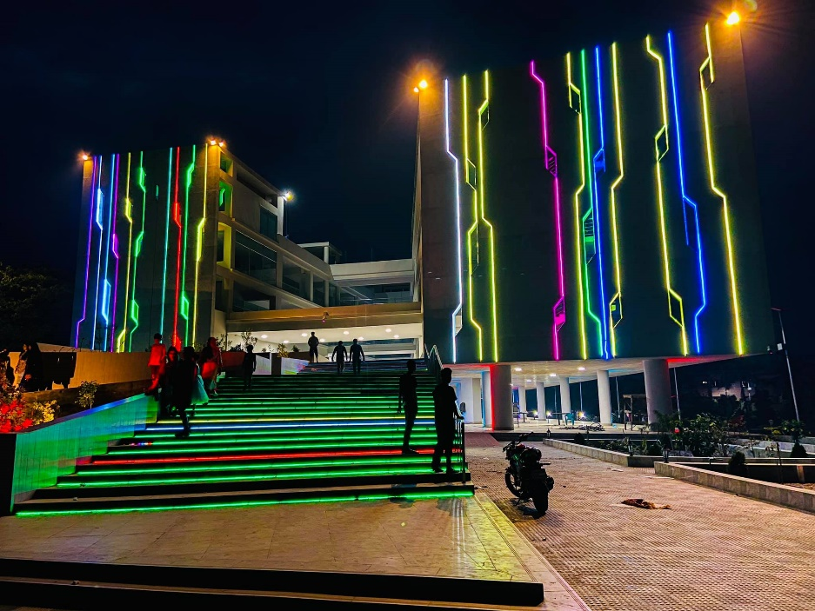
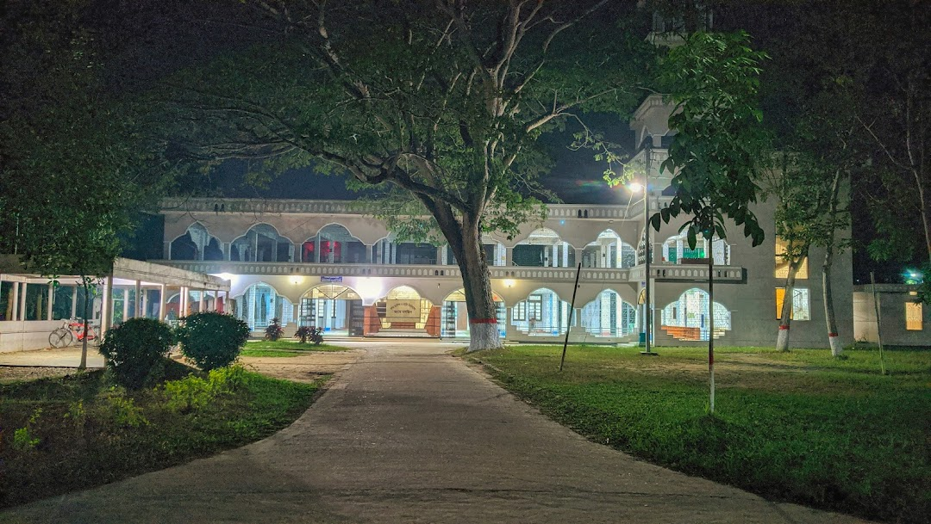
Beauties of kuet
Central Mosque
Sheikh Kamal IT Training &
Incubation Center
Durbar Bangla
10/5/2023
12

Slide 13
Achievements
University ranked 401-500 in Asia by 2022 QS World University Rankings
University ranked 1201-1500 in World by 2023 Times Higher Education World University Rankings
34 teachers from different faculties of KUET ranked among world's best scientists in AD Scientific index (October 2021)
10/5/2023
13

Slide 14
conclusion
KUET provides high-quality education to its students
KUET graduates are in high demand by employers worldwide
Many KUET alumni hold leadership positions in various industries
KUET is committed to maintaining its legacy of excellence
KUET aims to make a positive impact on society through teaching, research, and outreach programs
10/5/2023
14

Slide 15

THANKS for your Attention
Does anyone have any thoughts?
10/5/2023
15

